Slide 1





APPLICATION OF BIG DATA
USING BLUE BIKES
Made by:
- SHRADDHA THAKKAR
SUBMITTED TO:
PROF. VALERIY SHEVCHENKO
COURSE: ALY6110 71205 Data Management Big Data

Slide 2
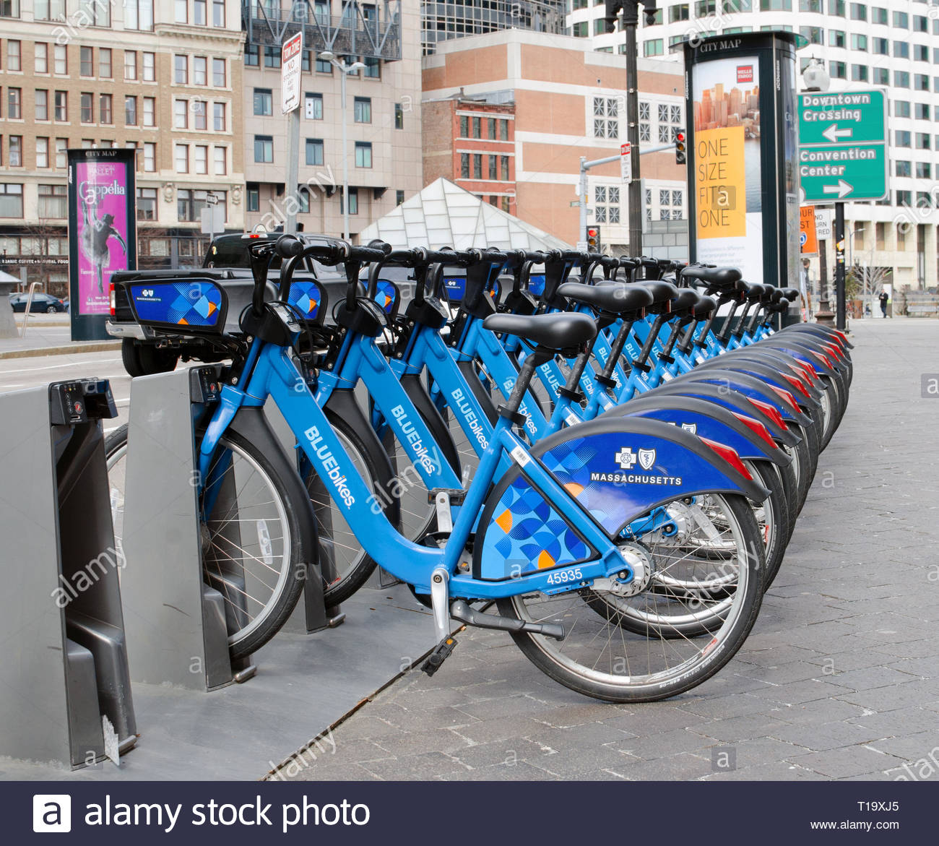
INTRODUCTION
Big Data is a field that focuses on ways to analyze, and systematically extract information from data sets that are too large to be deal with.
Here, we are working on one such real world data of blue bikes.

Slide 3

How Big Data is useful?
-The 5 V’s characteristics of Big Data: Volume,
Variety, Velocity, Value and Veracity encapsulates
the qualities associated with the big data.
- It helps in predictive analysis and capture,
Duration, sharing, as well as information privacy.

Slide 4
BUSINESS QUESTIONS?
How to improve the reach of blue bikes services.
Which stations makeup the most users?
Users by gender.
What’s the average trip duration?
Which months are the services used the most.

Slide 5
TOOLS USED:
Azure Databricks (IAAS)
Spark (SAAS)
SQL
Python
R

Slide 6
Dataset:
This dataset comprises of details of bluebikes like bikes out from station, information about the trips, bluebike usage members, station details in Boston. The timeframe of the data we are working on is “Oct 2018” to “Sep 2019”.
Data Dictionary:
Duration, StartTime and EndTime with Date timestamp, Station names, Bike ID, Birth year and Gender of members,

Slide 7
Steps taken to Analyze the Data:
Initially, Created Cluster on Azure.
Data merging: As quarterly data of BlueBikes contains less number of rows, we decided to merge the data of four quarters using R by the help of notebook in cluster created.
Uploaded the final dataset to the cloud ecosystem.
Create notebook for both Python and SQL

Slide 8
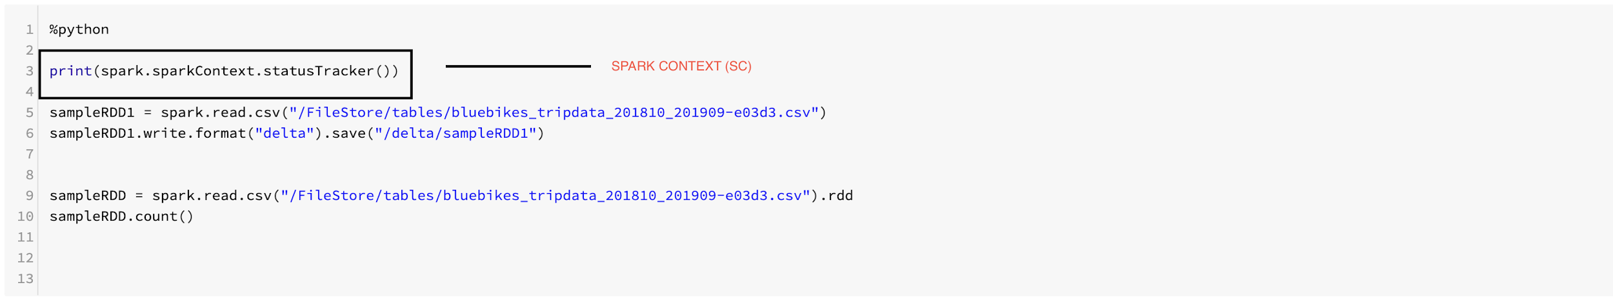
Steps:
Using python notebook and pyspark library, checking if there is connection with Spark Cluster to submit jobs.
Notes:
Sparkcontext is a connection with spark cluster. SC is entry point of spark which represents connection with spark cluster and also useful for creating RDD.

Slide 9
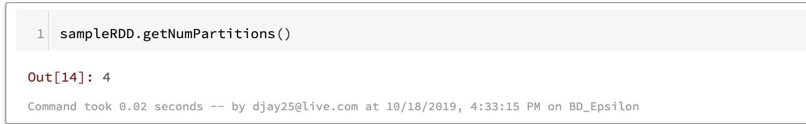
Steps:
If Spark context is running and connected, we will read the csv file using spark.read function which is part of Pyspark library.
Check the data is across the cluster. For that use getNumPartitions() method of Pyspark library. The data we uploaded is distributed across 4 nodes.

Slide 10
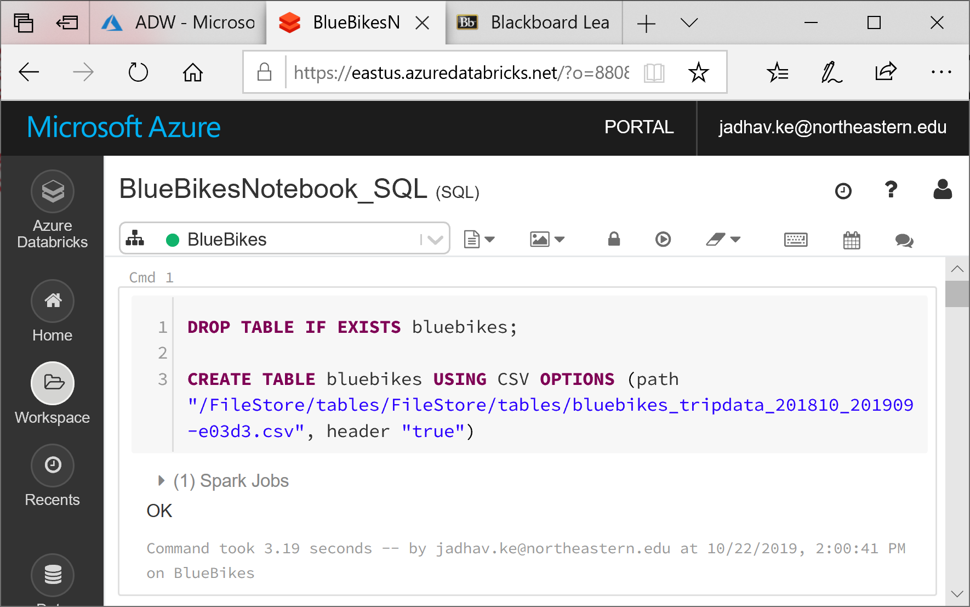
Analysis : Loading the data

Slide 11
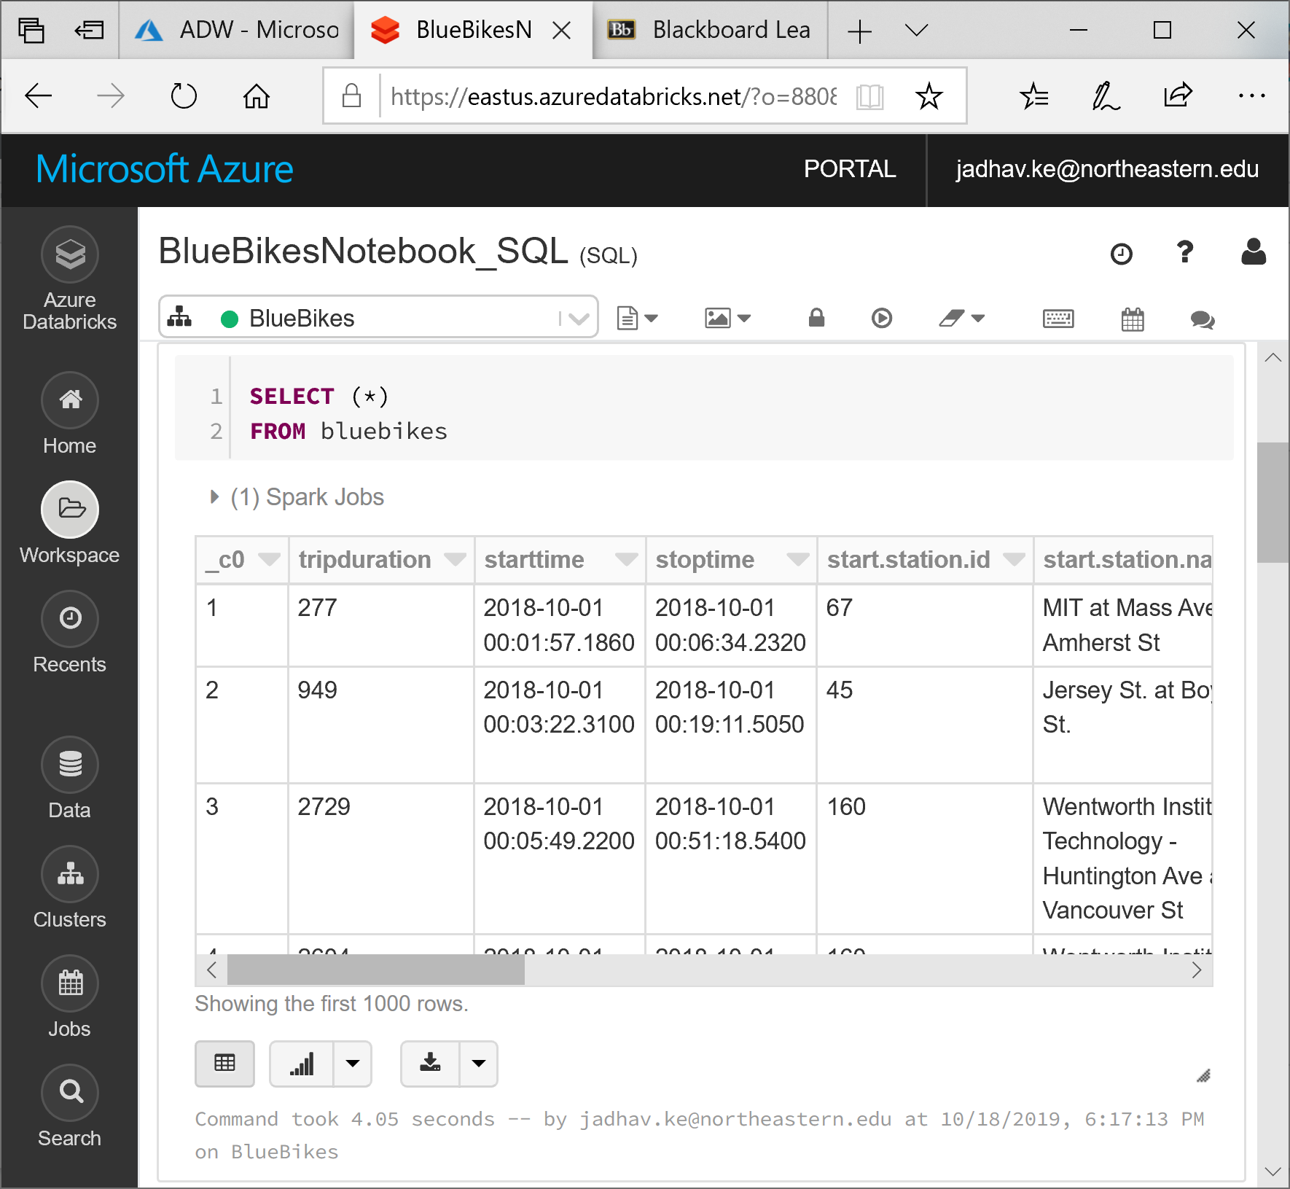
Analysis: Displaying the sample data

Slide 12

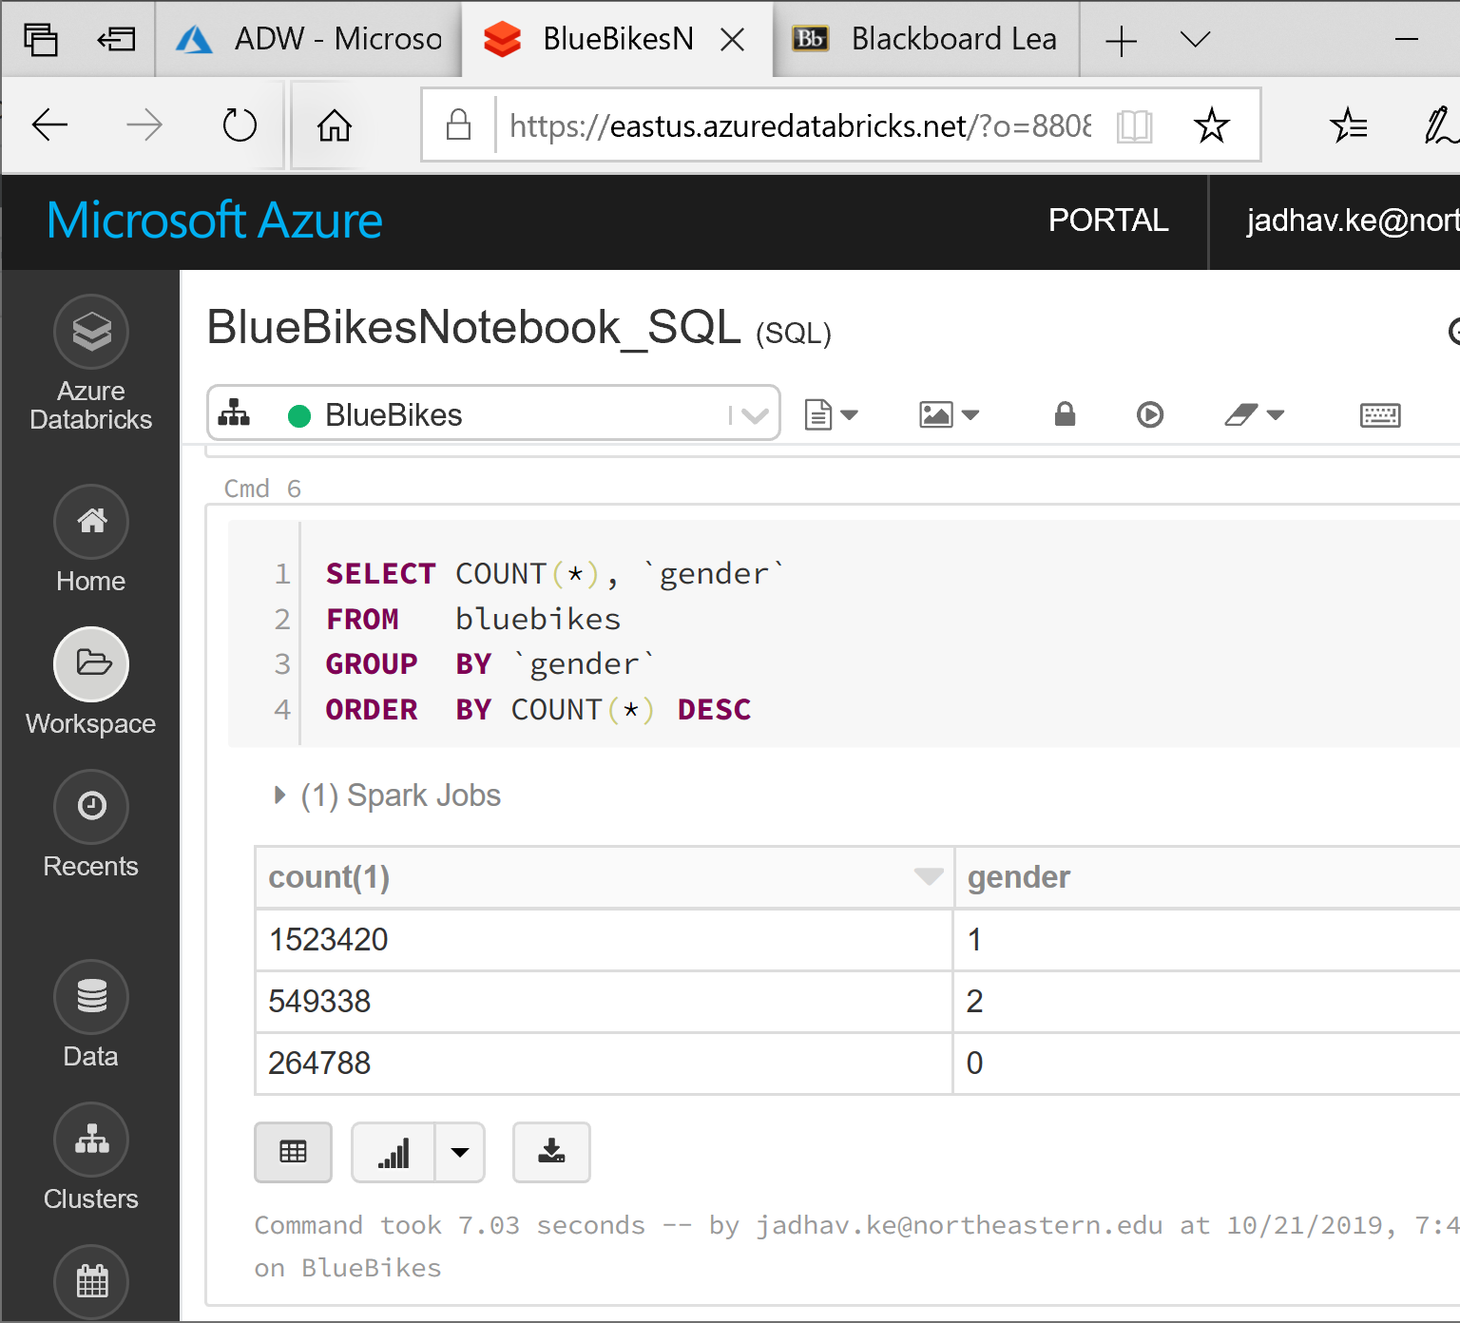
Analysis: Usage by Gender
Notes:
1- male, 2- female, 0- others

Slide 13
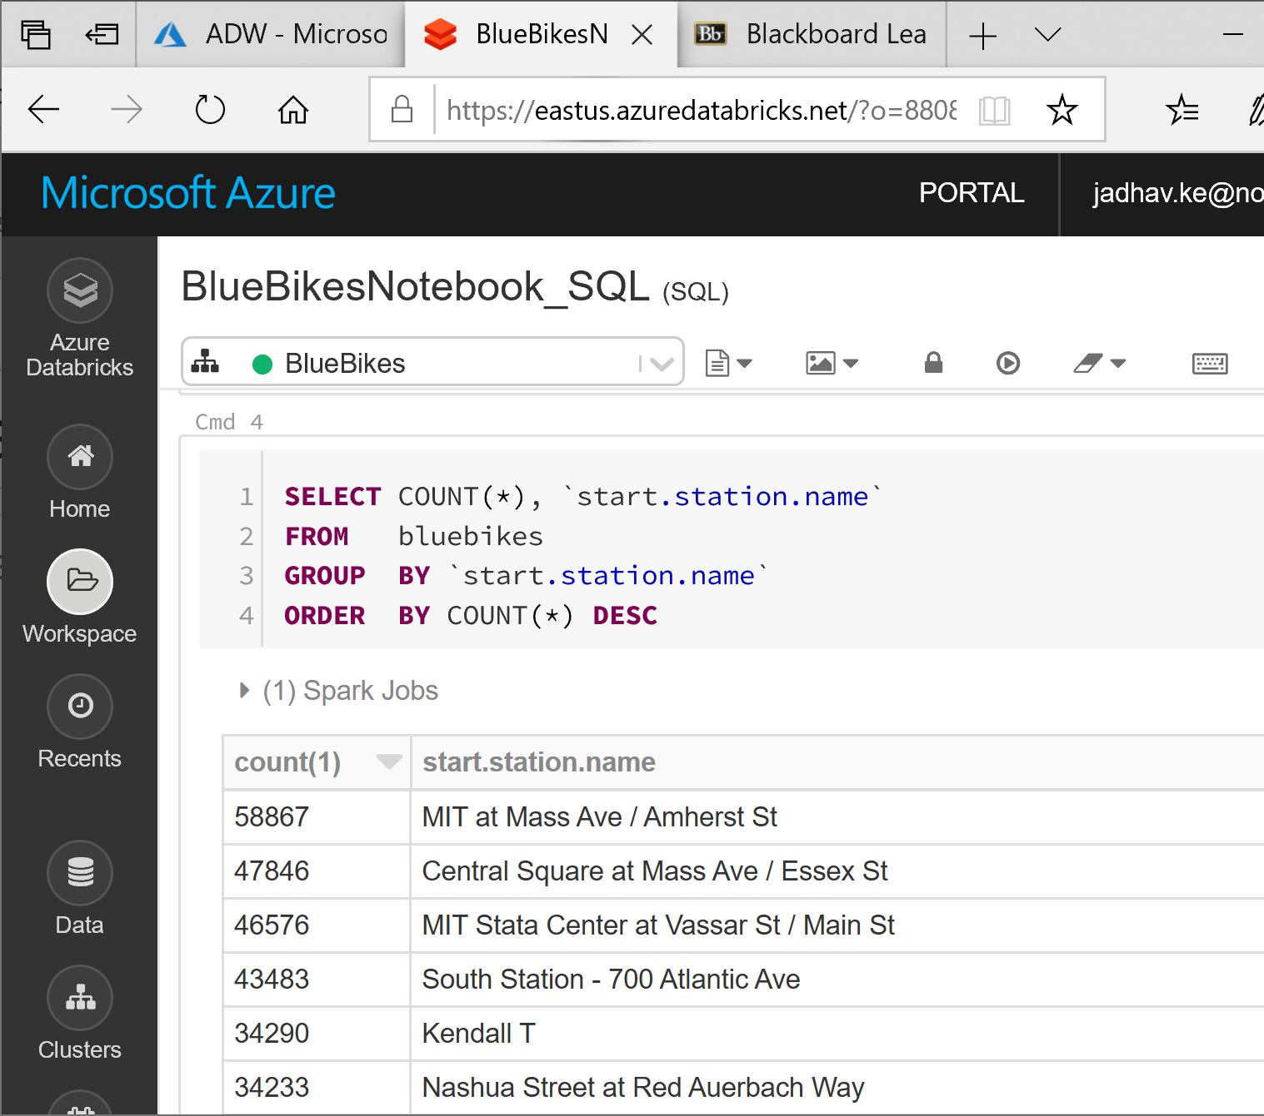
Analysis: Usage by start station

Slide 14
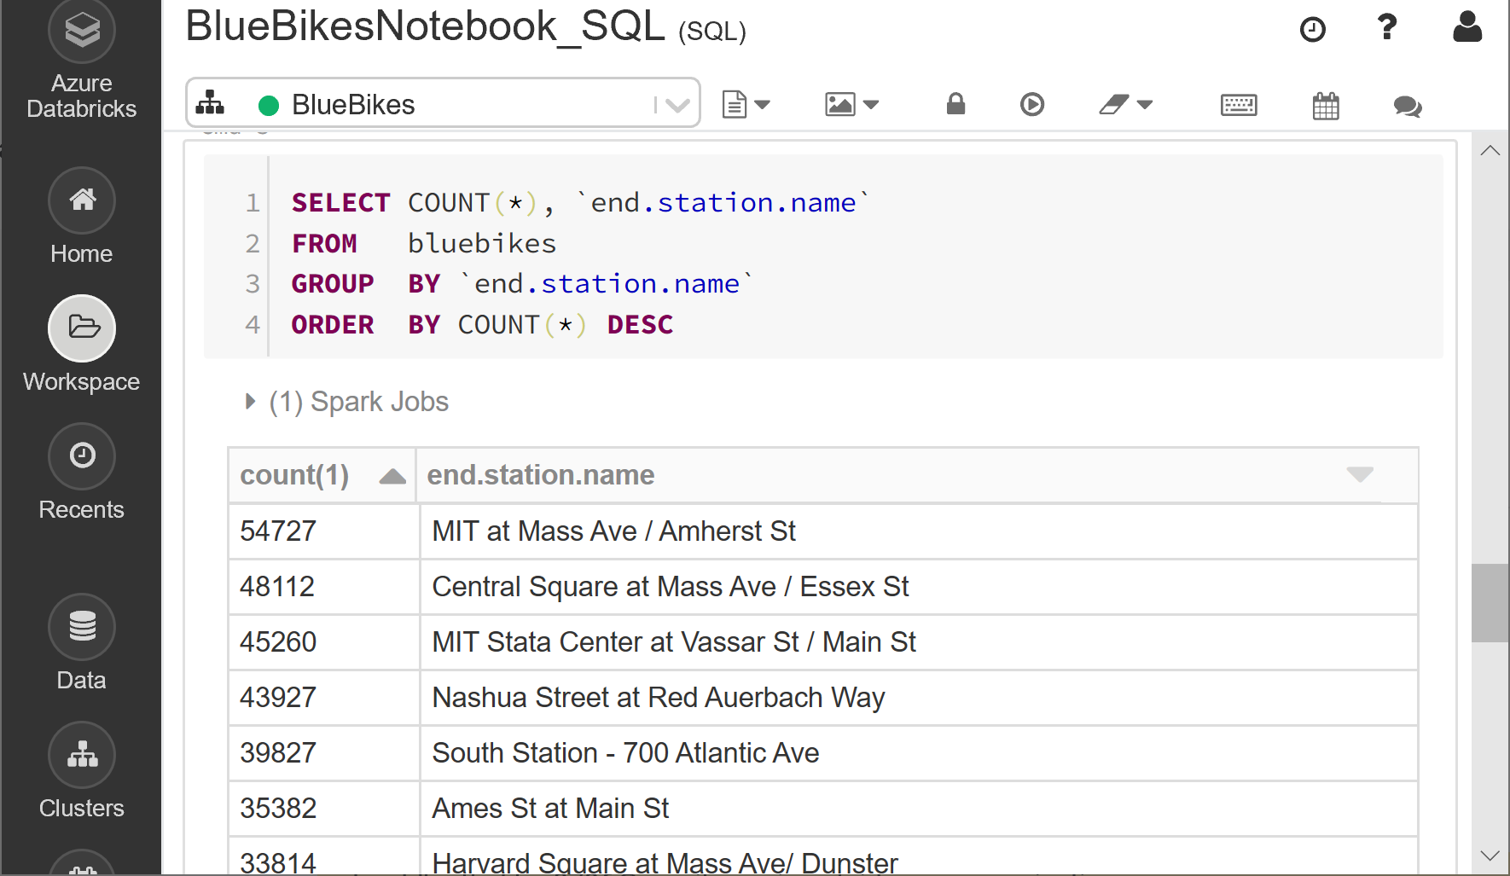
Analysis: Usage by end station

Slide 15
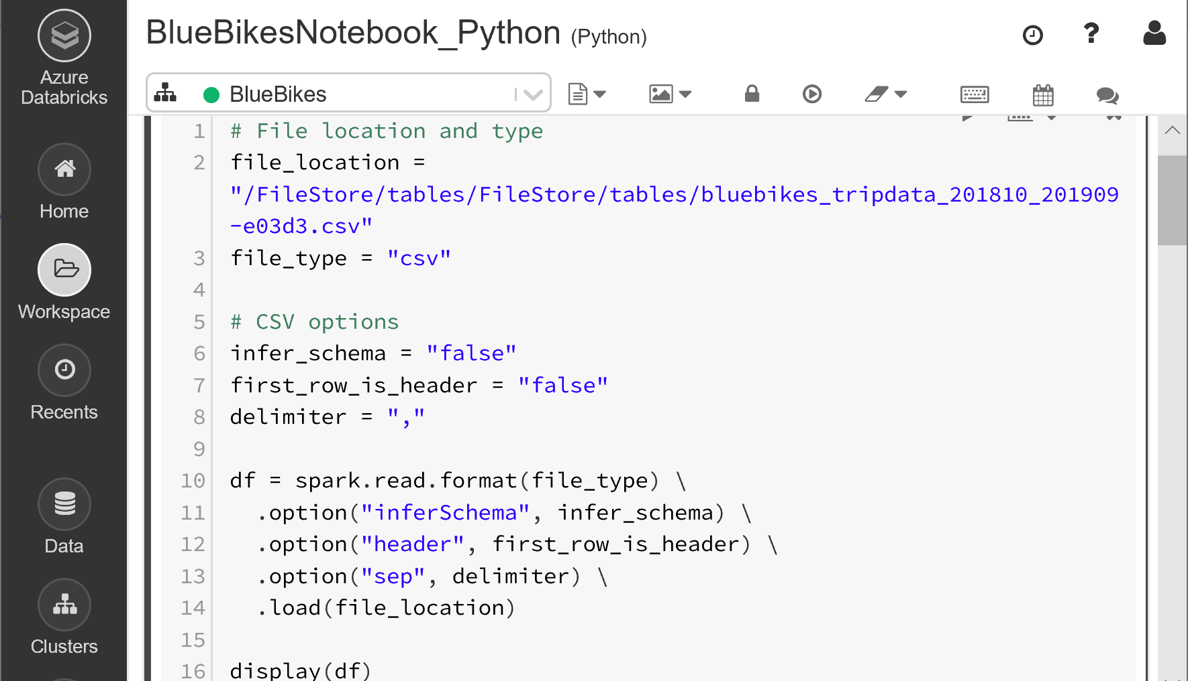
Analysis:

Slide 16
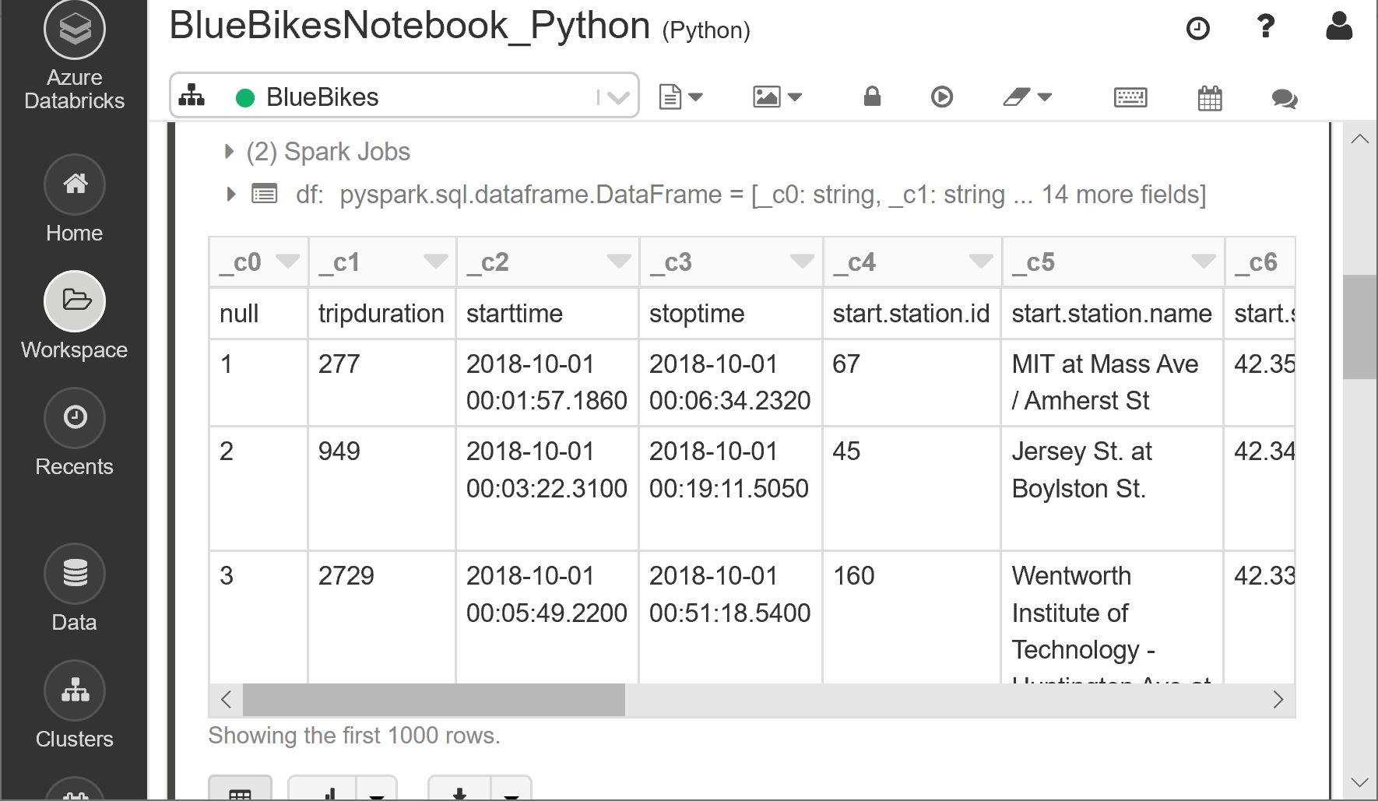
Analysis

Slide 17
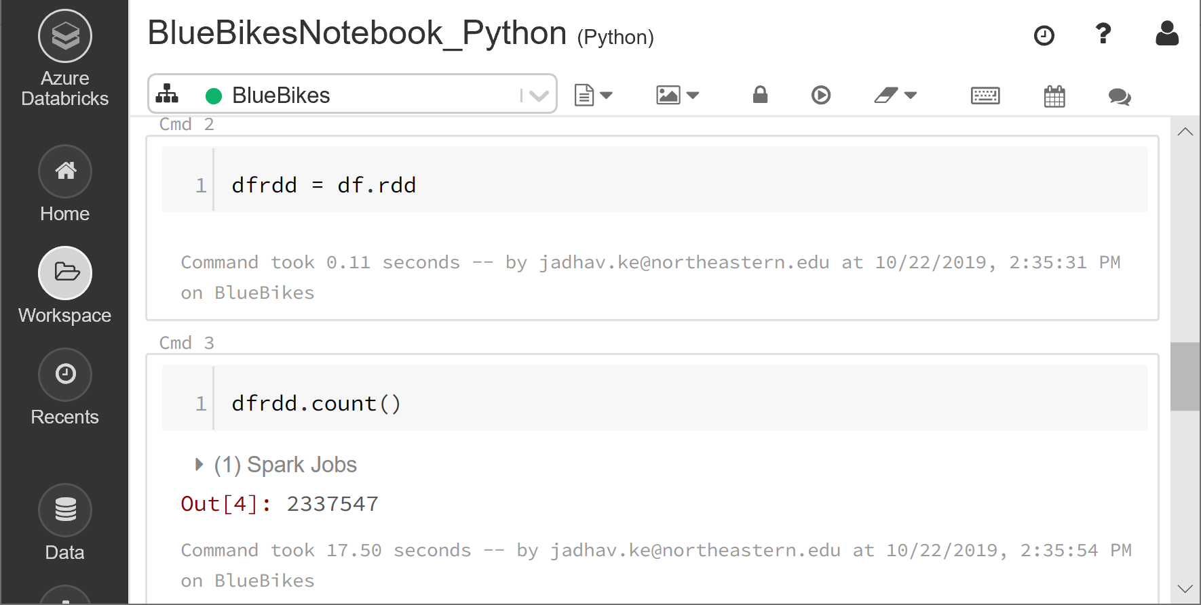
Analysis

Slide 18
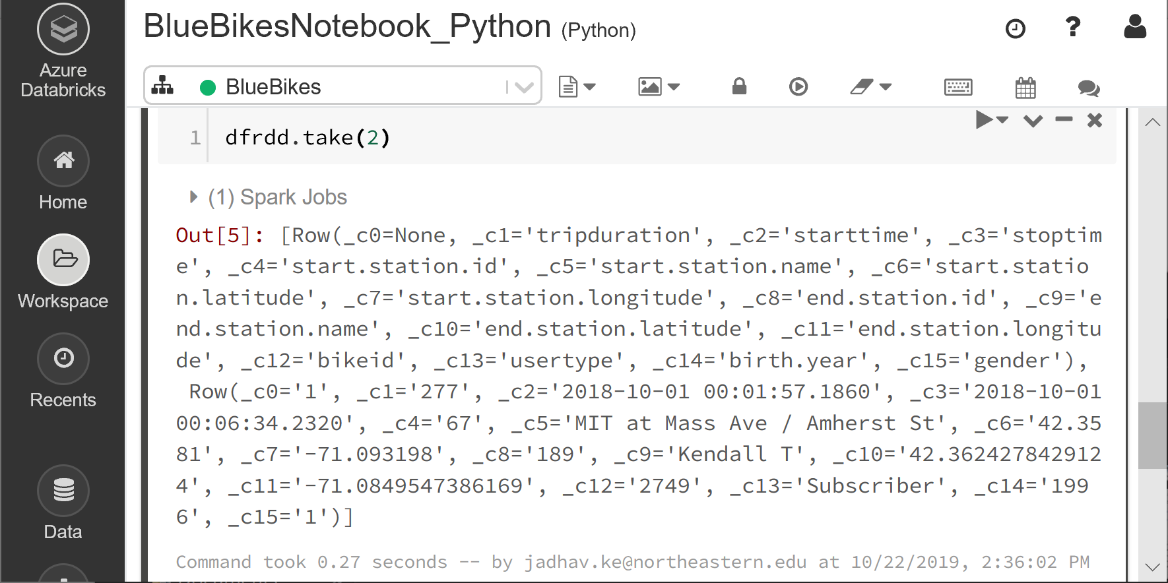
Analysis

Slide 19
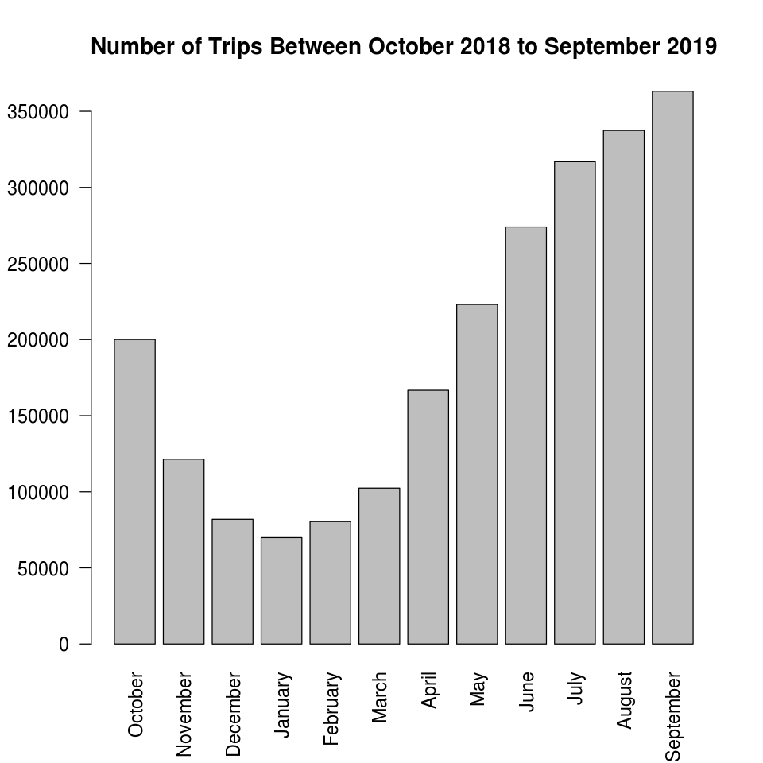
Analysis

Slide 20
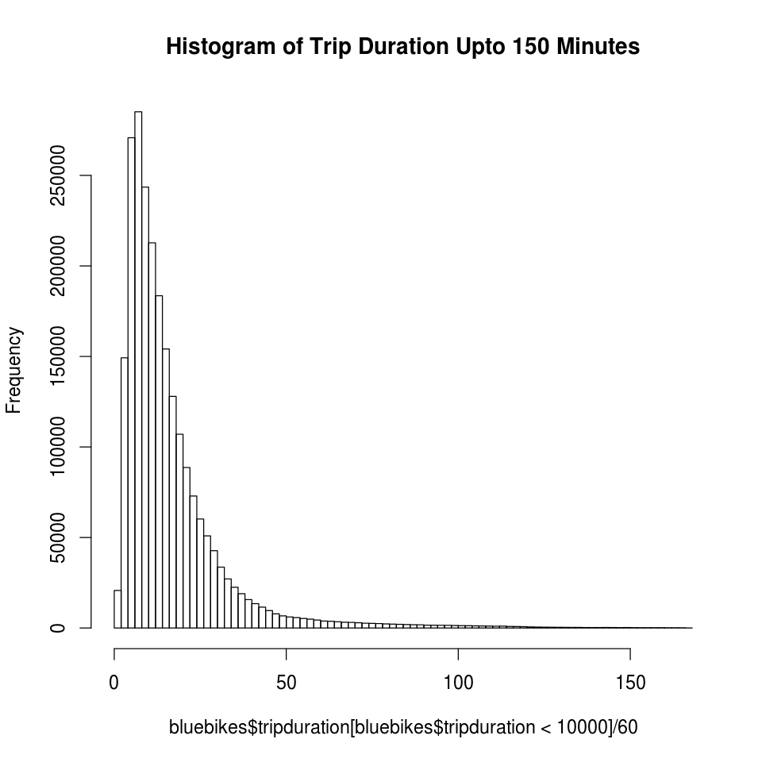
Analysis

Slide 21
Outcome of the analysis :
To find a way to increase the participation from women. Whose count is nearly 3 times less that of the men’s participation.
To either cut-off the maintenance cost during the period where bluebike services are being used less or to scale-up the services during the peak time.
To increase the number of bikes/services in the areas where the traffic is highest.

Slide 22
Future Scope:
As a future progress, we can change this data from stale to Realtime. Blue bike provides real-time endpoint which have real-time feeding of data in JSON format.
Example of JSON Format: https://member.bluebikes.com/data/stations.json
{"stations":[{"id":3,"s":"Colleges of the Fenway - Fenway at Avenue Louis Pasteur","n":"B32006","st":1,"b":false,"su":false,"m":false,"lu":1571284904646,"lc":1571285393331,"bk":true,"bl":true,"la":42.34011512249236,"lo":-71.10061883926392,"da":13,"dx":0,"ba":2,"bx":0,"d":"Boston"},{"id":4,"s":"Tremont St at E Berkeley St","n":"C32000","st":1,"b":false,"su":false,"m":false,"lu":1571282212267,"lc":1571285398300,"bk":false,"bl":false,"la":42.345392,"lo":-71.069616,"da":0,"dx":0,"ba":18,"bx":1,"d":"Boston"},{"id":5,"s":"Northeastern University - North Parking Lot","n":"B32012","st":1,"b":false,"su":false,"m":false,"lu":1571276590239,"lc":1571285451683,"bk":false,"bl":false,"la":42.341814,"lo":-71.090179,"da":12,"dx":0,"ba":2,"bx":1,"d":"Boston"},{"id":6,"s":"Cambridge St at Joy St","n":"D32000","st":1,"b":false,"su":false,"m":false,"lu":1571277909835,"lc":1571285438901,"bk":false,"bl":false,"la":42.36121165307985,"lo":-71.06530619789737,"da":3,"dx":0,"ba":12,"bx":0,"d":"Boston"},{"id":7,"s":"Fan Pier","n":"A32000","st":1,"b":false,"su":false,"m":false,"lu":1571268312059,"lc":1571285340213,"bk":false,"bl":false,"la":42.3533905070523,"lo":-71.04457139968872,"da":14,"dx":0,"ba":1,"bx":0,"d":"Boston"}

Slide 23


